Slide 1


A Top-Down Methodology for Global Urban Air Mobility Demand Estimation
Authors:
Akshay Anand (Presenter), Madhukar Mayakonda, Dr. Cedric Justin, Colby Weit, Jiajie Wen,
Dr. Turab Zaidi, Prof. Dimitri Mavris
Organization:
Centre National de la Recherche Scientifique (CNRS) and Georgia Tech at Lorraine’s Aerospace Systems Design Laboratory
AIAA AVIATION Forum, 15 – 19 June 2020
Copyright © by Madhukar P. Mayakonda, Cedric Y. Justin, Akshay Anand, Colby J. Weit, Jiajie (Terry) Wen, Turab A. Zaidi, Dimitri N. Mavris
Published by the American Institute of Aeronautics and Astronautics, Inc., with permission.
Notes:
Hello everyone, thank you for joining this presentation. My name is Madhukar Mayakonda, and I will be talking about a top-down methodology for estimating global urban air mobility demand.

Slide 2


Acknowledgements
This project has received funding from the Clean Sky 2 (CS2) Joint Undertaking (JU) under grant agreement No. 864521. The JU receives support from the European Union’s Horizon 2020 research and innovation programme and the Clean Sky 2 JU members other than the Union.
These results reflect only the author’s/Consortium view and Clean Sky is not responsible for any use that may be made of the information it contains.
This funding is supporting the “OASyS” project in the CS2 JU
OASyS: Overall Air Transport System Vehicle Scenarios
Notes:
This work part of the EU’s Clean Sky 2 joint undertaking, and funding has been made possible through the Horizon 2020 grant.

Slide 3
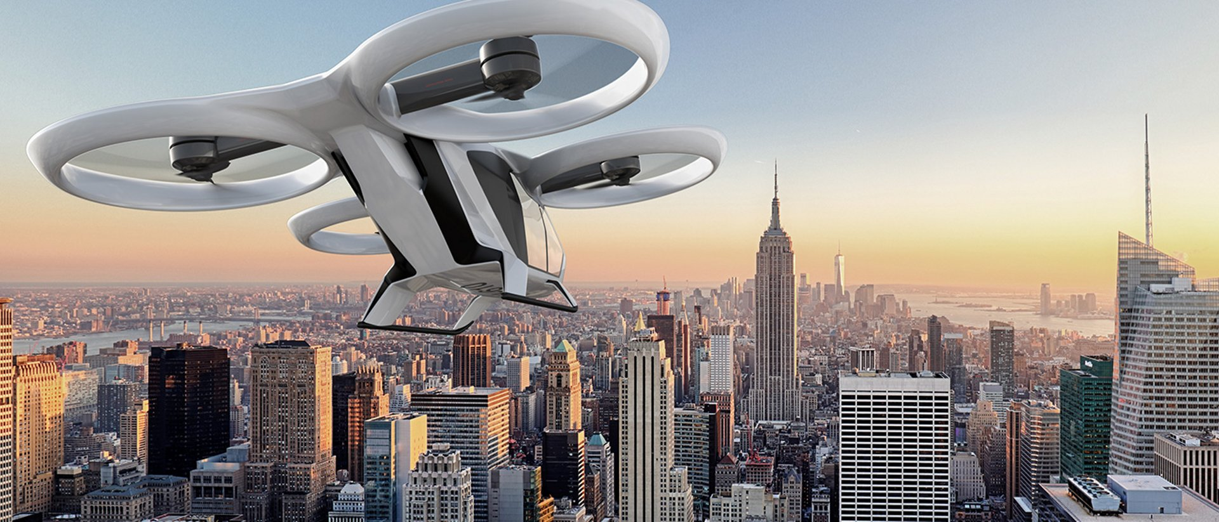
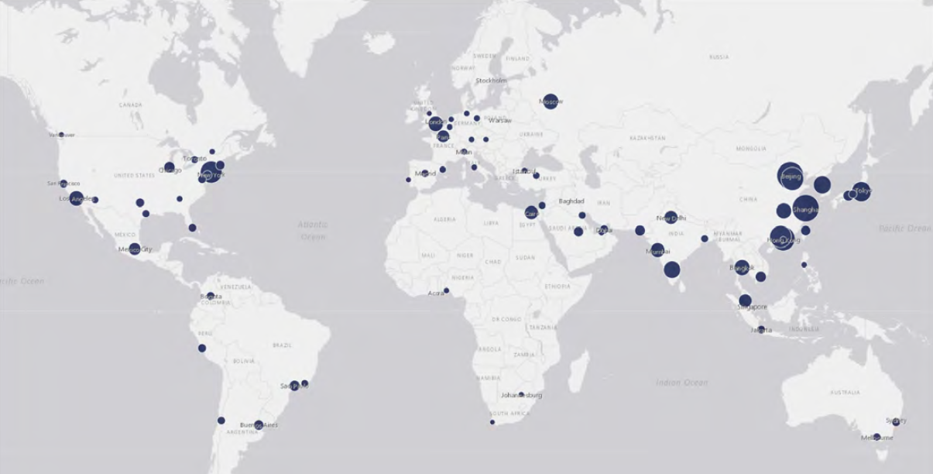
Research Objective
Credit: Airbus
Credit: KPMG
Urban Air Mobility (UAM): An air transportation system transporting people directly above populated areas
The methodology must be capable of estimating demand at the city level across global markets
Develop a methodology capable of generating demand estimations for urban air mobility operations across global cities
Notes:
I’ll be talking about urban air mobility, which for this presentation is defined as an air transportation system for people, operating above populated areas. The research objective of this project is to develop a methodology which is capable of generating demand estimates for a set of any cities across the globe. The challenge here will be creating a methodology which can consider the many different attributes of each city to generate an estimation.

Slide 4
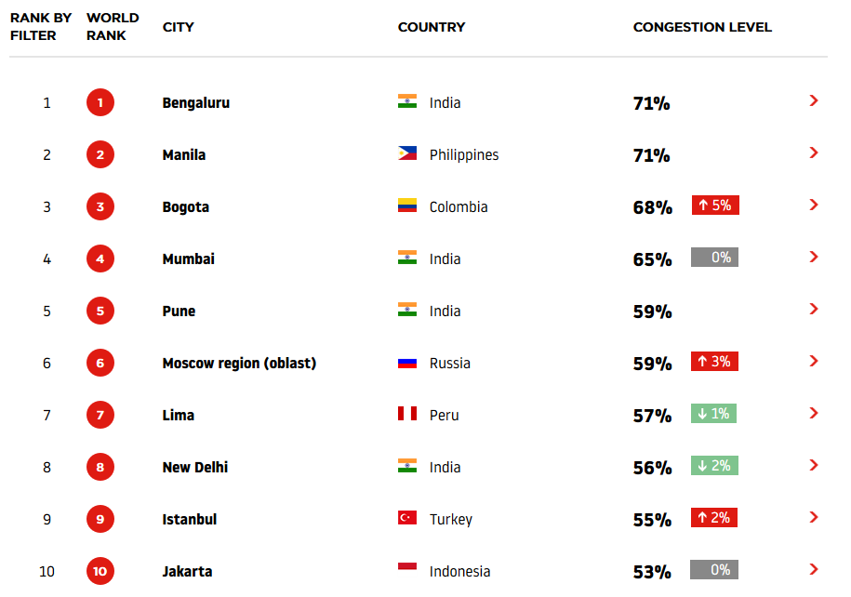
The Business Case of Urban Air Mobility
High and rising levels of roadway congestion is driving the need for a new, faster mode of transport
In 2017, roadway congestion cost US commuters and companies an estimated $166B for extra time and wasted fuel
Source: TAMU Mobility Report
Congestion level indicates additional time spent per trip, respective to uncongested baseline
Source: TomTom Traffic Index
Notes:
Urban air mobility concepts have a business case generated from high levels of roadway congestion in major cities around the world. This figure shows the congestion level, or percentage of extra time spent on a trip due to traffic. Travelers in each of the top 10 most congested cities spent more than 50% extra time on roadways. In the US, roadway congestion cost commuters and companies an estimated $166 billion from just wasted time and fuel.

Slide 5
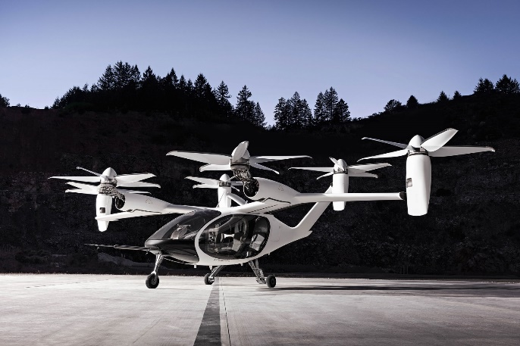
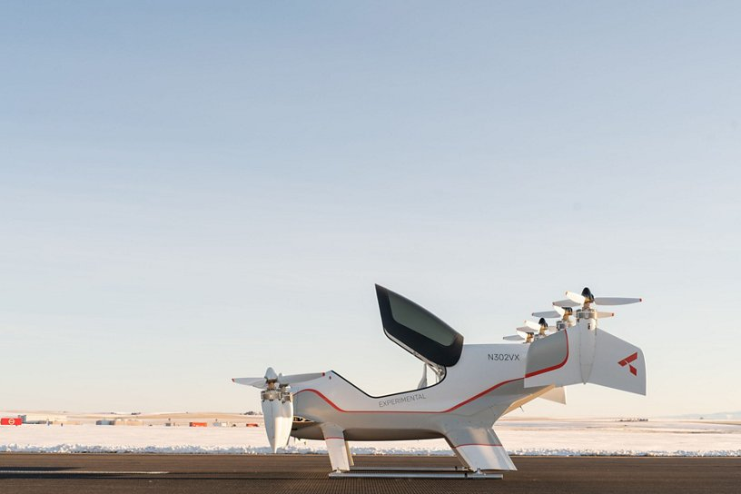
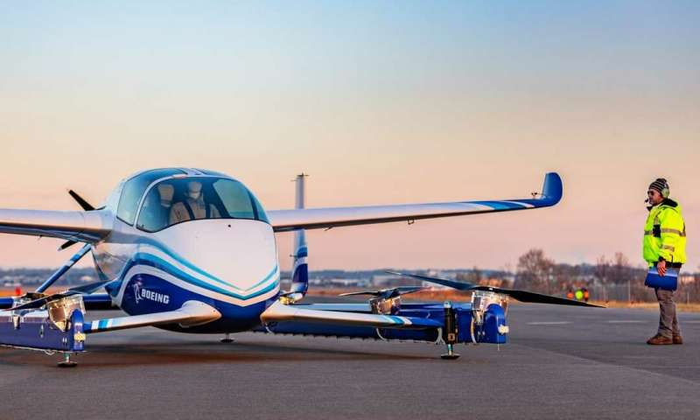
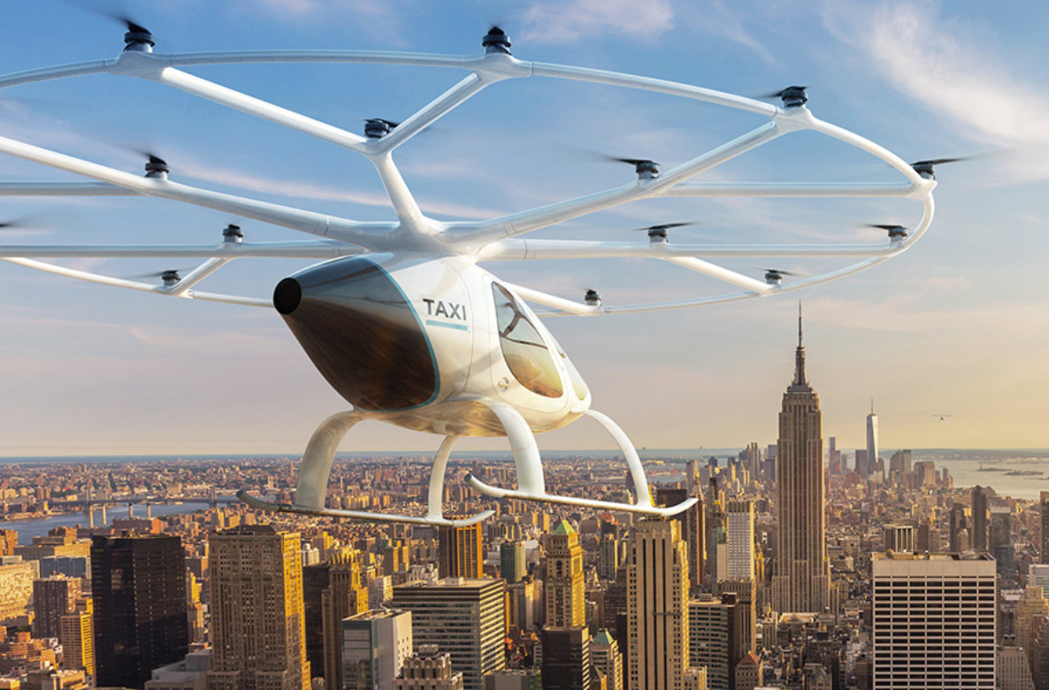
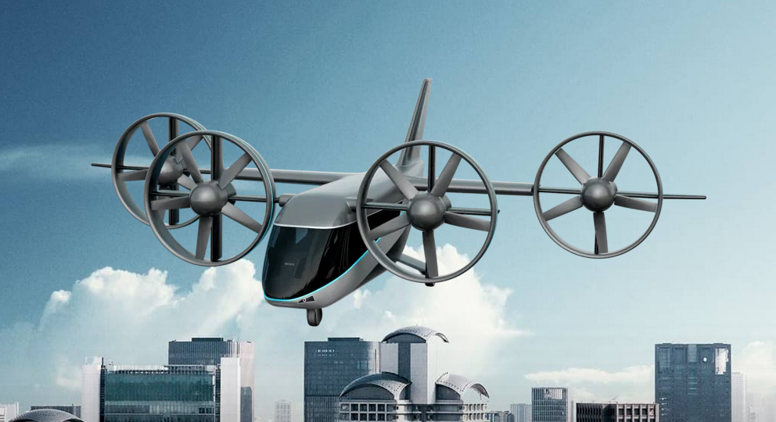
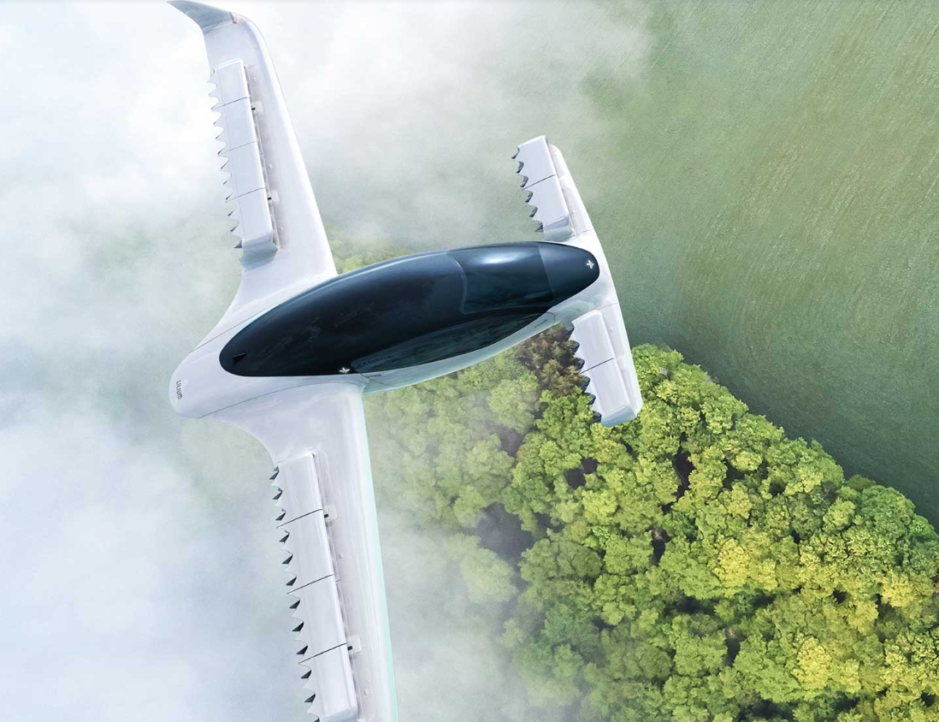
Over 70 Manufacturers Worldwide are Developing Urban Air Mobility Concepts
Joby Aviation
Airbus A³ Vahana
Boeing PAV
Volocopter VoloCity
Bell Nexus
Lilium
Notes:
So far, over 70 manufacturers worldwide have begun working on UAM concepts, including like Boeing and Airbus. A variety of trade-offs have been considered, and different concepts are optimized for different use cases. At the high level, the primarily differ in passenger capacity, cruise speeds, and range.

Slide 6
Many Barriers Towards UAM Viability Exist
Battery Technology
Battery Technology
Noise and Visual Disruption
Air Traffic Management
Noise and Visual Disruption
Air Traffic Management
Regulatory Requirements
Regulatory Requirements
Communications Infrastructure
Communications Infrastructure
UAM Viability
Autonomous Flight Technology
Autonomous Flight Technology
Proven Safety Record
Proven Safety Record
Vehicle Performance & Reliability
Vehicle Performance & Reliability
Certification Standards
Certification Standards
Vertiport Infrastructure
Environmental Restrictions
Vertiport Infrastructure
Environmental Restrictions
Source: Crown Consulting Inc
Non-exhaustive list
Need to understand and estimate the scale of UAM operations to make progress towards each of these barriers
Notes:
But for these concepts to be realized, a number of barriers need to be overcome. First, we have a set of barriers relating to regulations and creating an air traffic management system. Then there are barriers related to technology and infrastructure. And there exist some societal concerns as well with respect to noise and safety. In order to make progress towards each of these barriers, stakeholders need to develop an understanding of the demand for UAM trips.
For example, air traffic management, communications infrastructure, vertiport infrastructure, and noise considerations all need to know how many flights to expect per day.
For the development of environmental restrictions, the total volume of emissions needs to be understood.
And for developing technologies and supply chains, expected fleet sizes and levels of utilization need to be understood.

Slide 7
Current Demand Estimates
Market studies by consulting companies:
NASA-sponsored market reports:
Limited available literature regarding global UAM demand estimation methodologies
Company | Scope | Timeframe | Passenger Trips | Aircraft | Flight Hours
Roland Berger | Global | 2035 |  | 28 k
Horvath & Partners | 125 global cities | 2035 |  |  | 15 M
KPMG | 31 global cities | 2030 | 12 M
Porsche Consulting | Global | 2035 |  | 15 k
Company | Scope | Timeframe | Passenger Trips | Aircraft | Flight Hours
Roland Berger | Global | 2035 | 383 M* | 28 k | 38 M†
Horvath & Partners | 125 global cities | 2035 | 150 M† | 11 k* | 15 M
KPMG | 31 global cities | 2030 | 12 M | 876* | 1 M†
Porsche Consulting | Global | 2035 | 205 M* | 15 k | 21 M†
*Assuming an aircraft makes 15 trips per day, with 2.5 passengers per trip, on average
†Assuming 15 flight minutes per trip, on average
Company | Scope | Timeframe | Passenger Trips | Aircraft
Crown Consulting Inc. | 15 US cities | 2030 | 740 M | 23 k
Booz Allen Hamilton | All 484 US cities | Near-term | 30 M | 4.1 k
Notes:
There are some market studies which we can look to for context, but they don’t seem to provide the complete picture. These four market studies conducted by various consulting companies have come up with demand estimates across a few different metrics – passenger trips, fleet size, and flight hours.
The reports don’t provide demand estimates across every metric, so we made some assumptions to make better comparisons. Besides the outlier, KPMG, most of the reports suggest a few hundred million passenger trips, 10-30 thousand aircraft, and 10-40 million flight hours. All except KPMG are for the 2035 timeframe, and regard a global level set of cities. Unfortunately, none of these studies provide details regarding the methodology or assumptions used to generate these estimates.
Two separate market reports sponsored by NASA do give insight into their methodologies, data sources, and assumptions, however are limited in scope to the US; the approaches taken can’t be feasibly adopted to the global scale.
So in general, there is limited available literature regarding global UAM demand estimation methodologies, which is the gap this study will hope to make contributions towards.

Slide 8
Top Down Methodology
UAM will likely serve intracity and intercity regions, competing with traditional ground transport modes
Thus, UAM passenger kilometers traveled (PKM) may be estimated as a portion of the total PKM across all modes of ground transport
Traffic forecasting typically conducted using four-step transportation model
Infeasible to implement due to data availability, effort required, and computational expense
Generic Top-Down Approach:
Applied for UAM Demand Estimation:
Total Addressable Market
Total Ground PKM
Market Share
UAM Modal Split
Revenue
UAM Demand
An approach considering the inherent benefits of UAM without the need for traveler behavior data is desired
Notes:
As we try to understand how to estimate UAM demand, we should first look at the market which UAM will play a part in. Based on concepts under development, it is clear that UAM will likely serve intra and intercity regions, while competing with traditional ground transportation modes such as personal vehicles and public transport.
So, we can estimate UAM traffic to be a portion of the total traffic generated by travelers, which leads to this general top-down approach.
There have been lots of studies in the field of traffic forecasting, specifically aimed at enabling city planning organizations to intelligently plan for new infrastructure developments. One of the most commonly used model traffic forecasting models is the 4-step transportation model. Unfortunately, this process is depends on having access to high quality datasets for each region under study, and has high computational expense when considering a global set of cities. In the case of urban air mobility where no historical data exists, many traditional models won’t be sufficient.
Therefore, we need to find an approach which considers the inherent benefits of UAM, without the need for traveler behavior data.

Slide 9
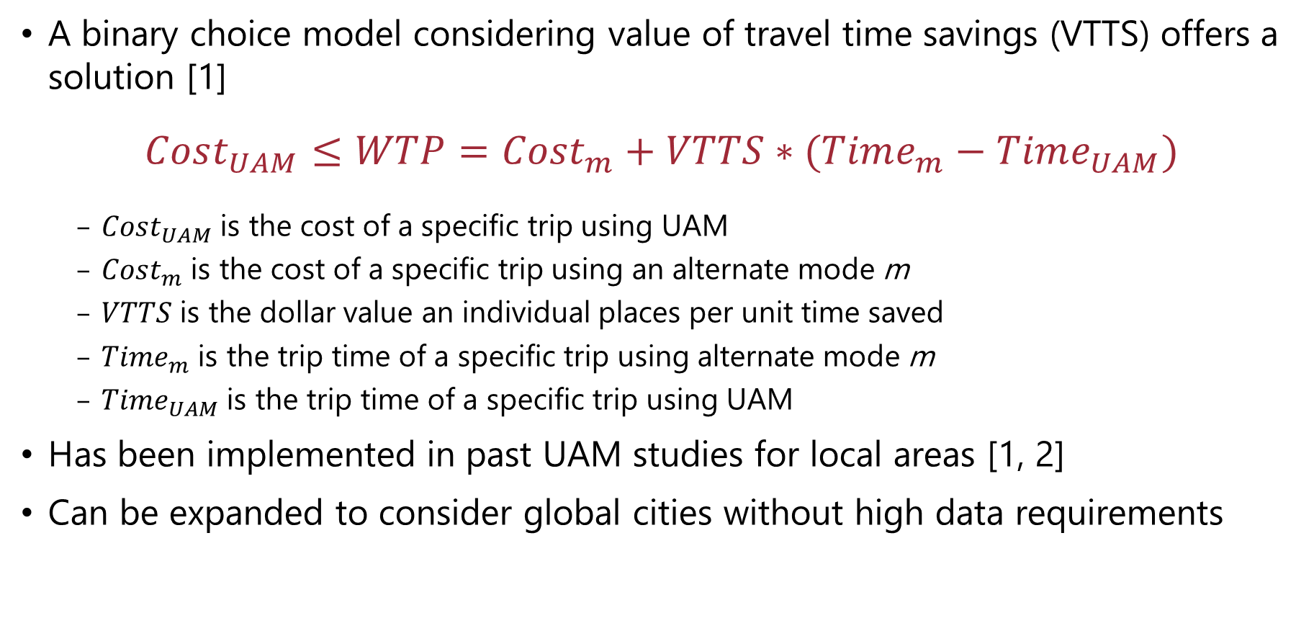
Estimating the value of travel time savings is a possible solution
A binary choice model considering value of travel time savings (VTTS) offers a solution [1]
$$Cost_{UAM}≤WTP=Cost_{m}+VTTS∗(Time_{m}−Time_{UAM})$$
$Cost_{UAM}$ is the cost of a specific trip using UAM
$Cost_{m}$ is the cost of a specific trip using an alternate mode m
$VTTS$ is the dollar value an individual places per unit time saved
${Time}_{m}$ is the trip time of a specific trip using alternate mode m
${Time}_{UAM}$ is the trip time of a specific trip using UAM
Has been implemented in past UAM studies for local areas [1, 2]
Can be expanded to consider global cities without high data requirements
[1] N. Sirirojvisuth, S. Briceno, and C. Justin, “Life-Cycle Economic Analysis and Optimization for Urban Air Mobility (UAM)” (2020)
[2] Booz Allen Hamilton, “UAM Market Study - Technical Out Breif” (2018)
Notes:
This brings us to a value of travel time savings approach. The equation shown here estimates the willingness to pay of travelers for a trip using Urban Air Mobility when compared to some alternate mode of travel. The willingness to pay is estimated as the sum of the cost of a traditional mode of transport, and the value a traveler would place on the time saved through a UAM trip.
This approach has been implemented in past UAM studies for local areas, so there is promise that it can be expanded to consider a global set of cities without the need for high data requirements. Therefore, we chose to develop a demand estimation methodology with this choice model.

Slide 10




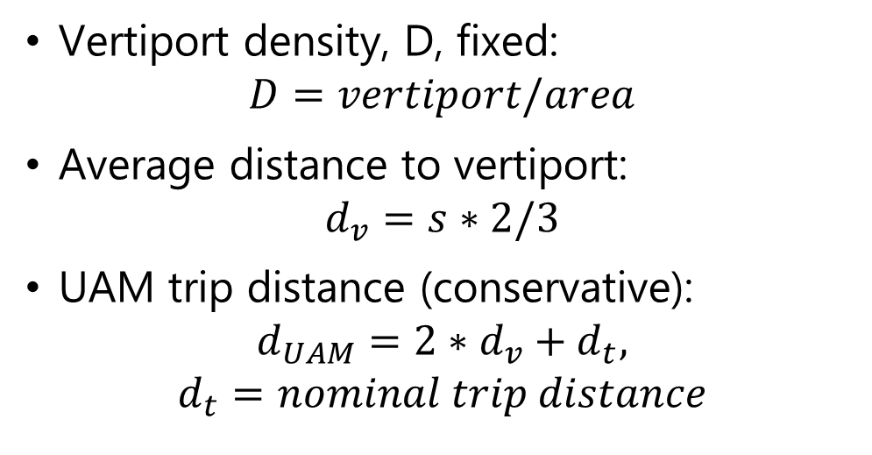
Concept of Operations (CONOPS)
Boarding
Vertiport Density
Destination
a
Access
Flight
Origin
Egress
a
s
Deboarding
Vertiport density, D, fixed:
$$D=vertiport/area$$
Average distance to vertiport:
$$d_{v}=s∗2/3$$
UAM trip distance (conservative):
$$d_{UAM}=2∗d_{v}+d_{t},$$
$$d_{t}=nominal trip distance$$
Area, A
Notes:
Before getting into the WTP equation, we need to discuss the concept of operations which will drive the calculations for UAM costs and travel times. So first, we note that Urban Air Mobility is actually a multi-modal travel option, where a traveler must take some secondary mode of transport to arrive and depart from the origin and destination vertiports.
The spacing of the vertiports will be controlled by assuming a uniform grid-like distribution and fixing a vertiport density, D. Of course, in an ideal world, we would perform this type of analysis at the OD level, and more intelligently place the vertiports, but when talking about a large set of cities and trying to avoid analyzing each city’s special attributes, that is not possible.
By making this assumption, we may estimate the average distance to a vertiport as 2/3 the diagonal radius. Again since an OD level analysis is not being performed and we don’t know the locations of the ODs with respect to the vertiports, we take a conservative estimate for UAM trip distance as 2 times the average distance to a vertiport plus the nominal trip distance.

Slide 11
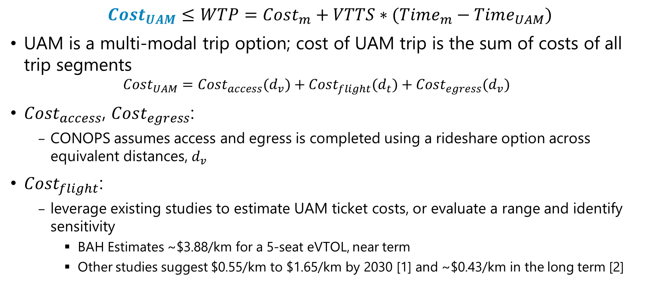
Estimating Market Share – UAM Trip Cost
$$Cost_{UAM}≤WTP=Cost_{m}+VTTS∗(Time_{m}−Time_{UAM})$$
UAM is a multi-modal trip option; cost of UAM trip is the sum of costs of all trip segments
$$Cost_{UAM}=Cost_{access}(d_{v})+Cost_{flight}(d_{t})+Cost_{egress}(d_{v})$$
$Cost_{access}$, $Cost_{egress}$:
CONOPS assumes access and egress is completed using a rideshare option across equivalent distances, $d_{v}$
$Cost_{flight}$:
leverage existing studies to estimate UAM ticket costs, or evaluate a range and identify sensitivity
BAH Estimates ~$3.88/km for a 5-seat eVTOL, near term
Other studies suggest $0.55/km to $1.65/km by 2030 [1] and ~$0.43/km in the long term [2]
[1] M. Kreimeier, P. Strathoff, D. Gottschalk, and E. Stumpf, “Economic Assessment of Air Mobility On-Demand Concepts” (2018)
[2] Uber Elevate “Fast-Forwarding to a Future of On-Demand Urban Air Transportation” (2016)
Notes:
Now, I will discuss each aspect of this willingness to pay function in detail. First, we take a look at estimating the cost of a UAM trip. The total cost is broken down as the cost for access and egress plus the cost of the flight.
For access and egress, we will assume a rideshare option is used to travel the average distance to a vertiport, as defined in the previous slide.
Estimating UAM flight cost however requires a detailed cost analysis and could be an entire effort on its own. Instead, we will look for guidance from existing studies and identify a selection of possible costs to evaluate. A survey of cost models finds costs ranging between about $4/km in the near term, down to less than half a dollar per km in the long term.

Slide 12
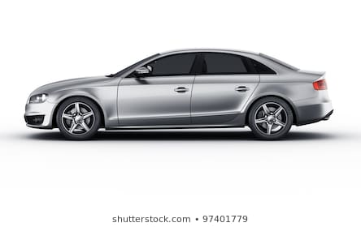
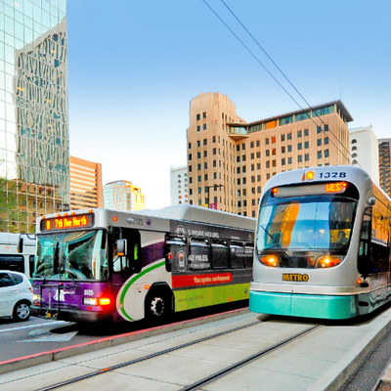
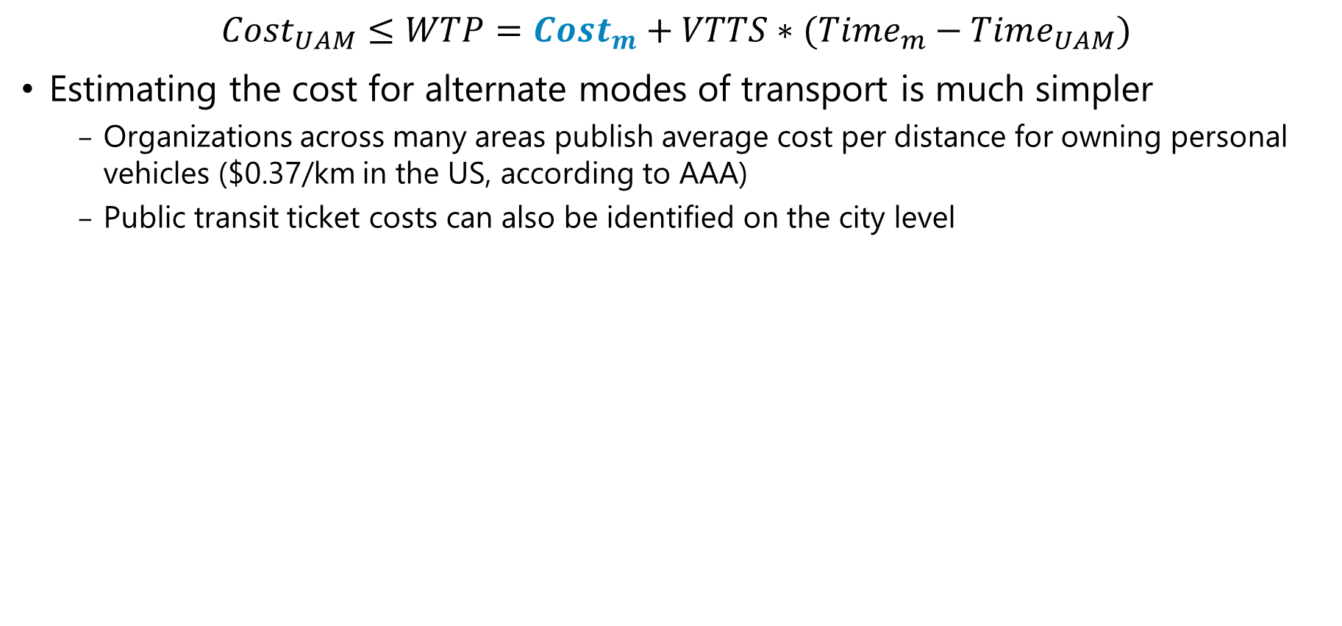
Estimating Market Share – Alternate Mode Trip Cost
$$Cost_{UAM}≤WTP=Cost_{m}+VTTS∗(Time_{m}−Time_{UAM})$$
Estimating the cost for alternate modes of transport is much simpler
Organizations across many areas publish average cost per distance for owning personal vehicles ($0.37/km in the US, according to AAA)
Public transit ticket costs can also be identified on the city level
PHX Public Transit
Personal Vehicle
Public Transit
Notes:
Estimating the cost of alternate modes is fairly simple, we assume a cost per distance for personal vehicles, and a cost per trip for public transit.

Slide 13
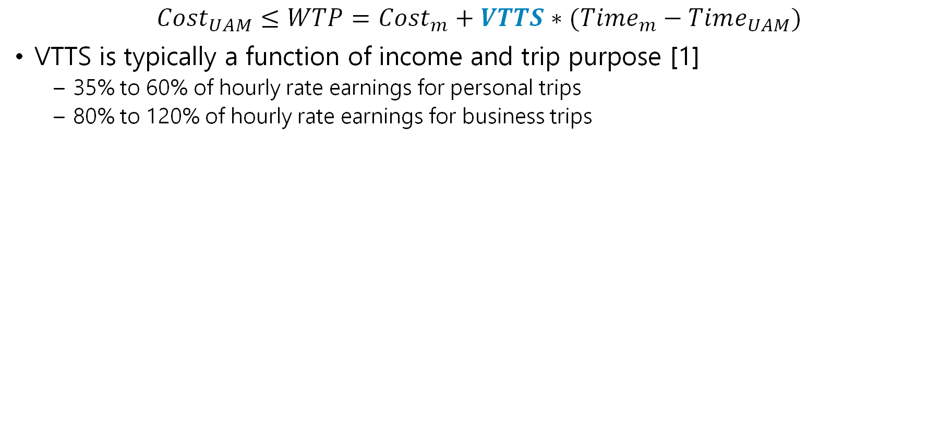
Estimating Market Share - VTTS
$$Cost_{UAM}≤WTP=Cost_{m}+VTTS∗(Time_{m}−Time_{UAM})$$
VTTS is typically a function of income and trip purpose [1]
35% to 60% of hourly rate earnings for personal trips
80% to 120% of hourly rate earnings for business trips
Business
Can be further disaggregated:
Work
Education
Shopping/Leisure
Vacation
Other
Personal
[1] "Revised Departmental Guidance on Valuation of Travel," U.S. Department of Transportation, Washington, DC, 2011.
Notes:
The value of travel time savings is estimated as a function of traveler income and trip purpose. As expected, trips for business place a much higher value on time savings than personal trips. The US DOT provides guidance on valuation and suggests time savings for personal trips are valued between 35 and 60% of hourly rate earnings, while business trips are valued at 80 to 120% of hourly rate earnings. In the implementation, we have assumed an average value, but these trip purposes could be broken down further to better justify an assumption for the specific value of VTTS.

Slide 14
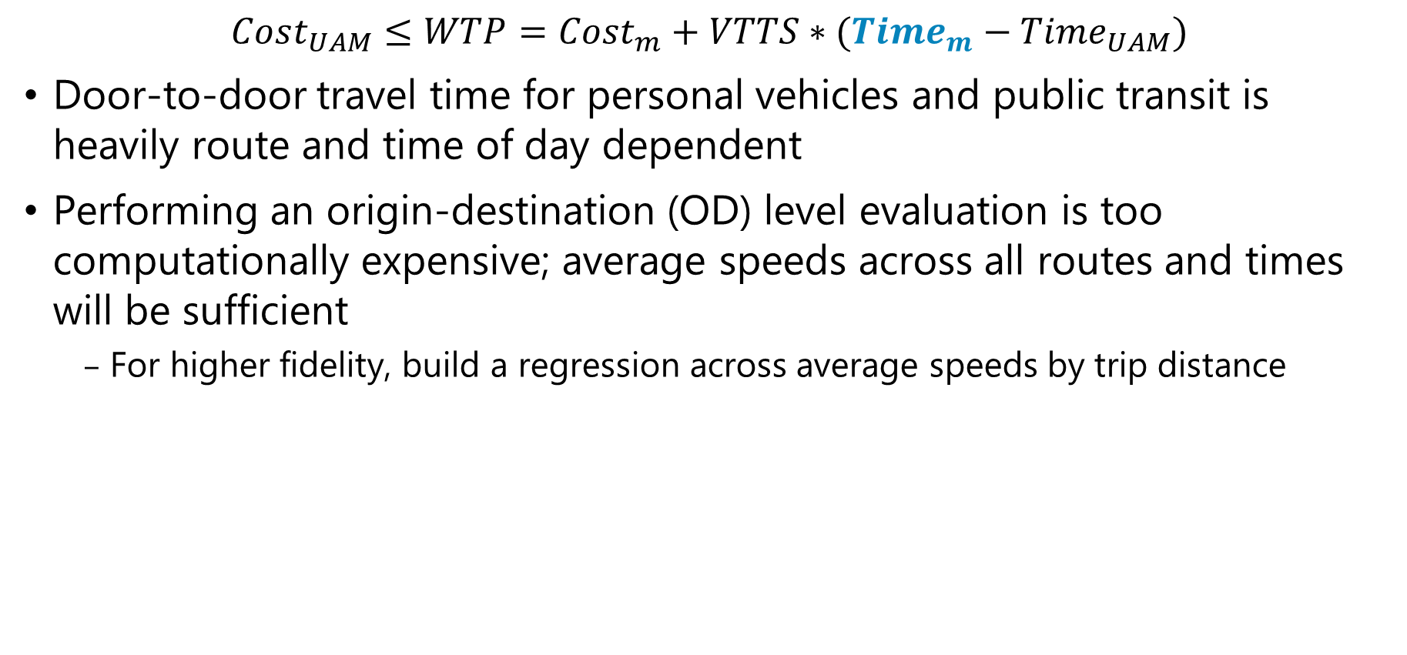
Estimating Market Share – Alternate Mode Trip Time
$$Cost_{UAM}≤WTP=Cost_{m}+VTTS∗(Time_{m}−Time_{UAM})$$
Door-to-door travel time for personal vehicles and public transit is heavily route and time of day dependent
Performing an origin-destination (OD) level evaluation is too computationally expensive; average speeds across all routes and times will be sufficient
For higher fidelity, build a regression across average speeds by trip distance
Logarithmic fit to randomly sampled routes in Paris using passenger vehicle
Notes:
The trip times for alternate modes of transport are generally dependent on the route taken and the time of day – whether it is during rush hour or not. As discussed previously, performing an OD level evaluation is not feasible, so we assume an average speed across all routes and times of day.
To earn some more fidelity, we may build a regression for average trip speed as a function of trip distance, since trips with longer distances will have higher average speeds and vice versa. This figure was generated by the team by sampling random points in Paris, France for passenger vehicles.

Slide 15
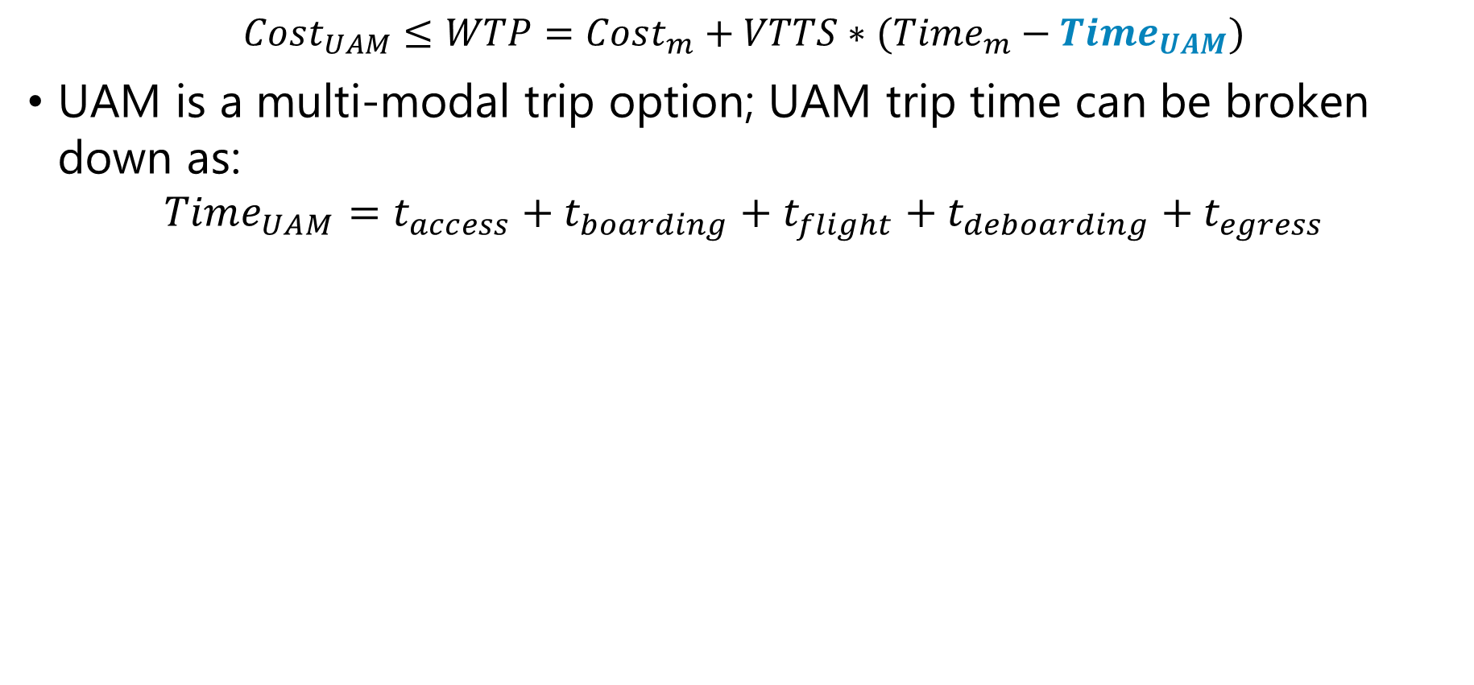
Estimating Market Share – UAM Trip Time
$$Cost_{UAM}≤WTP=Cost_{m}+VTTS∗(Time_{m}−Time_{UAM})$$
UAM is a multi-modal trip option; UAM trip time can be broken down as:
$$Time_{UAM}=t_{access}+t_{boarding}+t_{flight}+t_{deboarding}+t_{egress}$$
Boarding
Deboarding
Origin
Access
Flight
Egress
Destination
Rideshare Trip Time (avg vertiport distance)
Constant cruise speed
Rideshare Trip Time (avg vertiport distance)
Walking, ticket purchase, wait time, boarding, safety check
Deboarding, exiting
Notes:
And lastly, we have the time for the UAM trip, which has five major segments.
First, we have the time for the access trip, which as we stated before, will be through a road-based rideshare option. Here, the speed curve described earlier can be re-used.
The boarding time includes walking time within the vertiport, any potential ticket purchase times, wait times, boarding, and safety checks
Then the actual flight time estimation is simple, and following a constant cruise speed
Deboarding is much faster than boarding, and only considers deboarding and walking or exiting
Lastly, egress time is the same as access time, a rideshare trip.

Slide 16
Final Demand Estimation
All alternate travel mode options
WTP Function
Calculate UAM Traffic Volume (PKM)
All possible trip purposes
Viable space for UAM Travel
Discretized Range of trip distance
Discretized Range of income level
Total UAM PKM
Notes:
At this point, we have gone over the WTP function. During implementation of the methodology, this function is evaluated across the entire space of trips, described by travel mode options, trip purposes, trip distances, and traveler income levels. The evaluation and comparison to the cost of a UAM trip will find the specific range of these variables which are viable for UAM travel
Then, the next challenge is to estimate the amount UAM traffic associated with this viable space of trips.

Slide 17
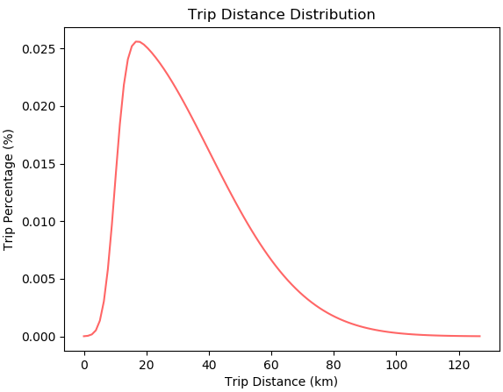
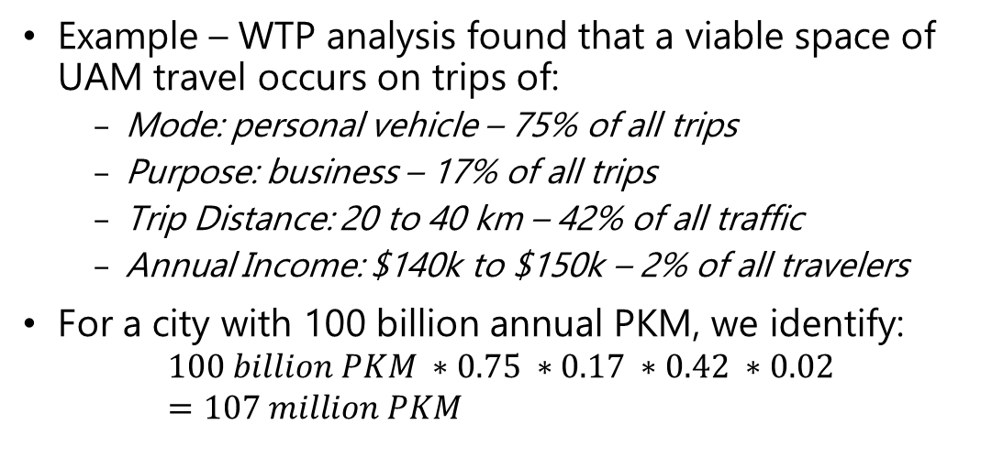
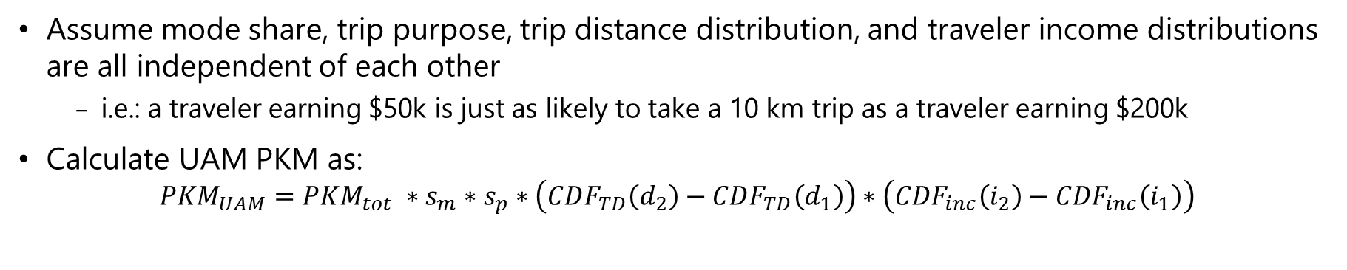
Estimating PKM Across Viable UAM Trips
Assume mode share, trip purpose, trip distance distribution, and traveler income distributions are all independent of each other
i.e.: a traveler earning $50k is just as likely to take a 10 km trip as a traveler earning $200k
Calculate UAM PKM as:
$$PKM_{UAM}=PKM_{tot} ∗s_{m}∗s_{p}∗\left(CDF_{TD}\left(d_{2}\right)−CDF_{TD}\left(d_{1}\right)\right)∗\left(CDF_{inc}\left(i_{2}\right)−CDF_{inc}\left(i_{1}\right)\right)$$
Example – WTP analysis found that a viable space of UAM travel occurs on trips of:
Mode: personal vehicle – 75% of all trips
Purpose: business – 17% of all trips
Trip Distance: 20 to 40 km – 42% of all traffic
Annual Income: $140k to $150k – 2% of all travelers
For a city with 100 billion annual PKM, we identify:
$$100 billion PKM ∗0.75 ∗0.17 ∗0.42 ∗0.02=107 million PKM$$
CDF(40) – CDF(20) = 42%
(Notional Figure)
Notes:
To do so, we make a crucial assumption: that the mode share, trip purpose, trip distance distribution, and traveler income distribution are all independent of each other. So for example, that means that a traveler earning $50k is just as likely to make a 10 km trip as another traveler earning $200k. By making this assumption, we can calculate the UAM PKM as a product of the percentage of trips each attribute represents.
So for example, suppose the WTP analysis found that a viable UAM trip is one which would normally be traveled using a personal vehicle for business purposes, across a trip distance between 20 and 40 km, where the traveler has an annual income between $140 and $150k. The percentage of traffic associated with the range of trip distance and income is found by taking the cumulative distribution function, as shown on a notional figure to the right.
So for a city which has 100 billion annual passenger kilometers traveled, we identify that roughly 100 million passenger kilometers would switch to using UAM.

Slide 18
Final Demand Estimation
All alternate travel mode options
WTP Function
Calculate UAM Traffic Volume (PKM)
All possible trip purposes
Viable space for UAM Travel
Discretized Range of trip distance
Discretized Range of income level
Total UAM PKM
Notes:
This then summarizes the developed methodology. We incorporated a willingness to pay analysis by estimating the value of travel time savings to find trips which are viable for UAM travel. Then we estimated the total traffic in terms of passenger kilometers traveled across each of these trips, which are described based on their travel mode, purpose, distance, and traveler income.

Slide 19
Scope of Cities for Implementation
KPMG suggests UAM will likely target high-density business travel routes used by a relatively price-insensitive customer base, and has identified 31 cities to see initial operations [1]
This implementation will consider the same set of cities, during year 2035
Tokyo | Shanghai | New York
Beijing | Seoul | Los Angeles
Osaka | Guangzhou | Tianjin
Mexico City | Shenzhen | Sao Paulo
London | Paris | Chicago
Bangkok | Jakarta | Wuhan
Kuala | Dallas | Hong Kong
Toronto | Madrid | Houston
San | Melbourne | Sydney
Washington DC | Phoenix | Taipei
Dubai
[1] “Getting Mobility Off the Ground,” Tech. rep., KPMG LLP, 2019
Notes:
Now, we present a sample implementation across a selection of 31 cities for the year 2035. This implementation is intended to display the capability of the developed methodology, and to identify preliminary trends or relationships.

Slide 20
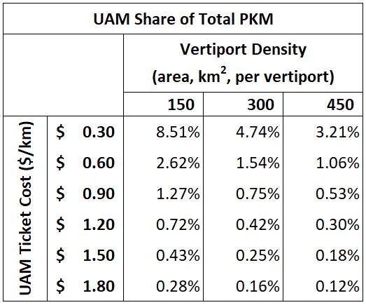
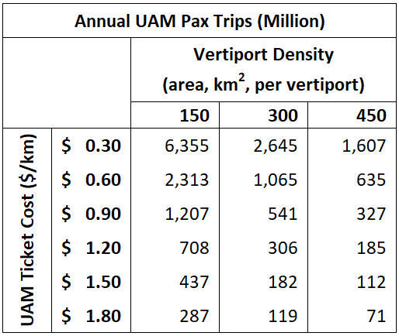
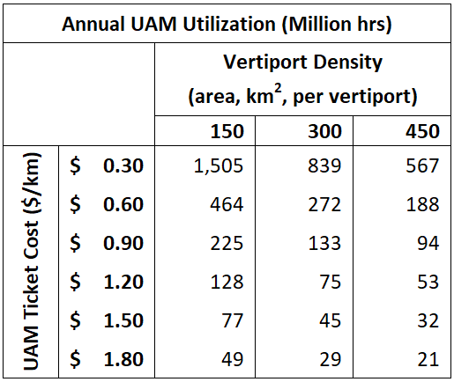
Results
For reference:
UAM Cost: $0.93/km (2030), CCI; $1.30/km (initial) and $0.43/km (near-term), Uber
300 km²/vertiport equates to ~21 vertiports in Los Angeles
Range of estimates by consulting companies:
Pax Trips: 12 M – 740 M
Flight hours: 1 M – 123 M
Strong market demand exists for a range of UAM ticket costs and vertiport densities
Notes:
The results, which are based on a number of assumptions not discussed in this presentation, show strong market demand across a range of UAM ticket costs and vertiport densities. The share of total traffic addressed by UAM ranges from about a tenth of a percent up to 8.5 percent. The sudden increase in demand between $0.30/km and $0.60/km is likely due to UAM trip costs becoming cheaper than operating personal vehicles, which was about $0.36/km in the US. Since that price point likely won’t be achieved by 2035, the more realistic upper limit is likely between 2.5-3% of all ground transport.
The equivalent ‘realistic’ upper limit observed for passenger trips is around 2.5 billion, and 450-500 flight hours. For reference, the demand estimates provided in the market reports discussed during the beginning of this presentation generally lie between $1.20/km and $0.90/km.

Slide 21
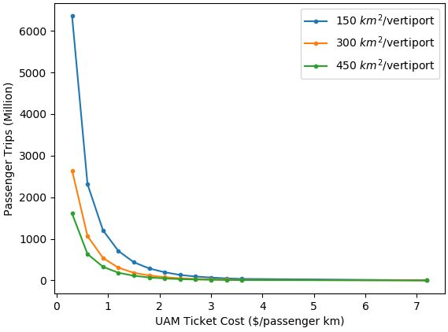
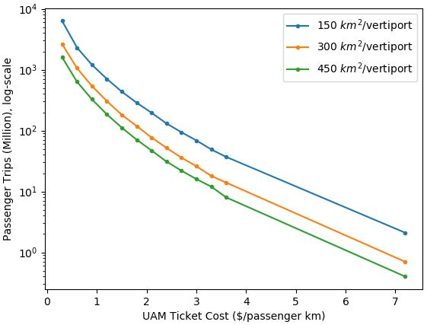
Results
Passenger trips increase exponentially with decreasing UAM ticket costs
Faster than exponential increase at $0.30/km
Assumed cost for passenger vehicle is $0.37/km
Notes:
When observing this data in a graphical format, we are also able to notice that passenger demand increases exponentially, or faster than exponential as the ticket cost decreases. The faster and exponential trend occurs at $0.30/km, as expected.

Slide 22
Conclusion
Strong market demand exists for a range of UAM ticket costs and vertiport densities, ranging from 70 million annual pax trips globally up to 6.3 billion pax trips
Demand expands exponentially with decreases in ticket cost and area/vertiport
Manufacturers may leverage these results to identify and plan for an optimal production rate
City planners must focus on developing vertiport infrastructure quickly and efficiently
By 2035, air traffic management systems should have the capability to handle mature operations
Regulators must move quickly to outline vehicle certifications and flying regulations
Notes:
In conclusion, we find strong market demand exists for a range of UAM ticket costs and vertiport densities, ranging from 70 million annual pax trips globally up to 6.3 billion pax trips across the costs evaluated.
Demand expands exponentially with decreases in ticket cost and area/vertiport
Manufacturers may leverage these results to identify and plan for an optimal production rate
City planners may seek to couple this information with a supply side analysis to see how much demand can physically be met, and create plans for infrastructure development
By 2035, air traffic management systems in cities should have the capability to handle tens of thousands of passengers per day
Regulators must move quickly to outline vehicle certifications and flying regulations to enable manufacturers and cities to begin developing these capabilities

Slide 23



Acknowledgments
In addition to the Clean Sky 2 Joint Undertaking, the authors would like to thank the following entities and people for their contributions:
German Aerospace Center (DLR)
Ralf Berghof
Nico Flüthmann
Aerospace Systems Design Laboratory OASyS Advisory Board
Dimitri Mavris
Holger Pfaender
Elena Garcia
Georgia Tech – Lorraine / Centre National de la Recherche Scientifique
Abdallah Ougazzaden
Jean-Paul Salvestrini
Alexandre Locquet
Nadege Werkle-Dastillung
Notes:
Thank you for tuning in. The other authors and I would also like to thank these individuals for their highly valuable contributions towards the success of this project.

Slide 24

Thank you!
Questions?
Akshay Anand
Researcher, Georgia Tech Lorraine / CNRS
aanand@georgiatech-metz.fr
Notes:
Are there any questions?

